Slide 1
Instagram Performance Analytics for Sugar Cosmetics
Data-Driven Strategies for Audience Growth and Engagement
- By Komal S. Vishwakarma

Slide 2
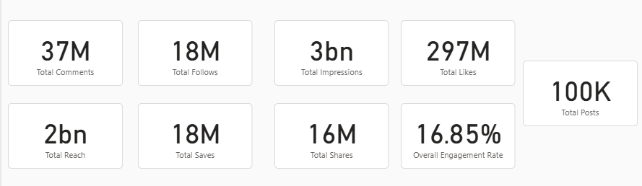
Key Performance Indicators (KPIs)
Massive Brand Awareness: We've achieved massive visibility with 3 Billion impressions and 2 Billion in reach, showing incredibly strong brand awareness.
High Engagement Volume: This visibility is backed by high-volume audience interaction: 297 Million likes, 37 Million comments, and 18 Million saves.
Stellar Engagement Rate: With 100,000 posts and 18 Million followers, the account maintains an exceptional 16.85% engagement rate, which is far above industry benchmarks and signals a highly active community.

Slide 3
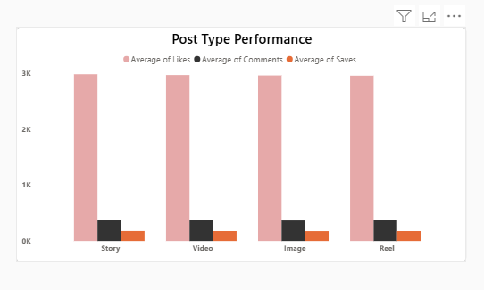
Content Performance: What's Working?
Reels are the Undisputed Winner: Our analysis is clear: Reels are the most powerful format, leading across all key metrics—likes, comments, and saves.
Exceptional Consistency: Audience affinity is strong, with all posts exceeding 1 Million likes. The average engagement rate per post is a remarkably high and consistent 18.27%.
Strategic Format Use:
Videos and Images perform well but clearly trail the engagement of Reels.
Stories underperform in this area and are best used for retention or driving traffic (CTAs), not for primary engagement.

Slide 4
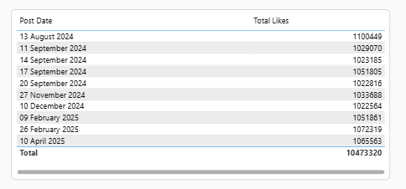
Top Posts

Slide 5
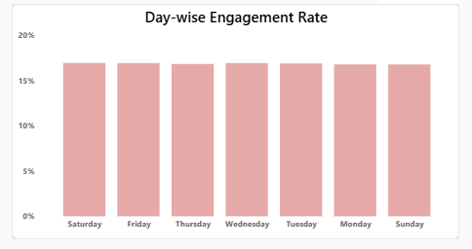
Timing & Frequency: When to Post?
Finding 1: The Audience is Always On. A major finding is that engagement is uniform across all days of the week. There is no need to restrict our schedule to specific "peak days." This gives us complete scheduling flexibility.

Slide 6
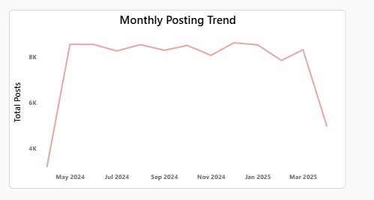
Timing & Frequency: When to Post?
Finding 2: Posting is Driven by Campaigns. The posting strategy is stable, with a significant spike in May 2024 (likely a major campaign) and a dip in March 2025 (a possible strategic pause).
Key Takeaway: Our posting schedule should be dictated by our marketing calendar, not by a specific "best day."

Slide 7
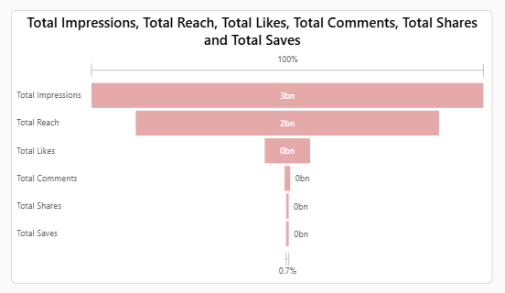
The "Reach vs. Engagement" Gap
The Core Challenge: This is our most critical insight. We have a massive visibility of 3 Billion impressions, but this only translates to a 0.7% engagement-to-impression ratio.
What This Means: This signals a "Reach-Engagement Gap." While we are excellent at getting content seen (passive viewing), we are missing opportunities to get that massive audience to interact (active engagement).
The Hypothesis: The content may lack strong enough hooks, compelling storytelling, or precise targeting to convert passive viewers into active engagers.

Slide 8
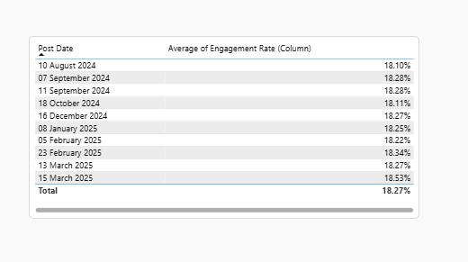
Top Engagements

Slide 9
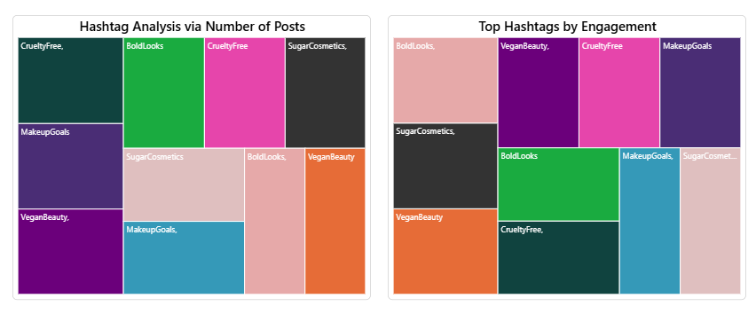
Hashtag Analysis & Optimization
Top Performers: The hashtags #BoldLooks and #VeganBeauty are our sweet spot. They drive both high usage and high engagement.
Over-Used / Under-Engaging: Conversely, core brand tags like #SugarCosmetics and #CrueltyFree are over-used but deliver low engagement. They are taking up valuable caption space.
The Action: We must re-evaluate our hashtag mix, reducing reliance on the under-performing tags and increasing the use of our proven top performers.

Slide 10
Final Strategic Recommendations
Double-Down on Reels: Given Reels are the undisputed engagement leader, we must prioritize Reel production for all key announcements and storytelling to maximize interaction.
Bridge the Engagement Gap: We must address the 0.7% impression-to-engagement ratio. We recommend A/B testing stronger hooks in the first 3 seconds of Reels and adding clearer Calls-to-Action (CTAs) in captions to convert viewers.
Optimize Hashtag Strategy: Immediately reduce the use of #SugarCosmetics & #CrueltyFree. Replace them with high-performers like #BoldLooks and #VeganBeauty to improve our engagement efficiency.
Replicate Success: Form a team to analyze the April 2025 peak posts (1.1M+ likes) and the June 2024 campaign spike. We must identify what made them successful and build a playbook to replicate it.

